Slide 1
Lifecycle and methodologies in OSS - Comparing OSS development methodologies with traditional methodologies
Dr. Ritu Arora
Assistant Professor (Off-Campus)
Department of Computer Science & Information Systems
BITS, Pilani

Slide 2
OSSD vs. Waterfall Model
OSSD model is different from the traditional Waterfall or Cascading model of software development
The traditional software development model comprises of six activities:
Collecting and analysing requirements
Designing a solution
Developing the code
Testing
Deployment
Maintenance
These activities are arranged in a linear fashion
Work starts on a particular activity only after the previous activity is completed

Slide 3
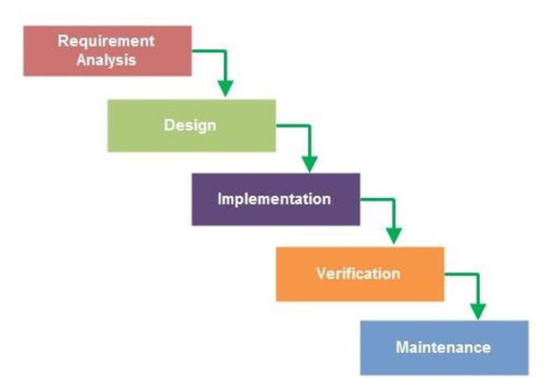
Waterfall Model
Waterfall Model: Linear development model

Slide 4
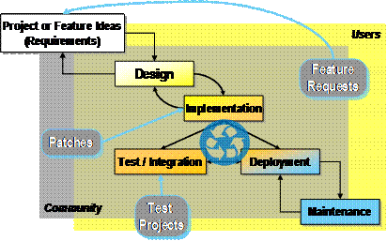
Open Source Software Development Model
(Source: Haddad, Ibrahim, and Brian Warner. "Understanding the open source development model." Linux Journal (2011))

Slide 5
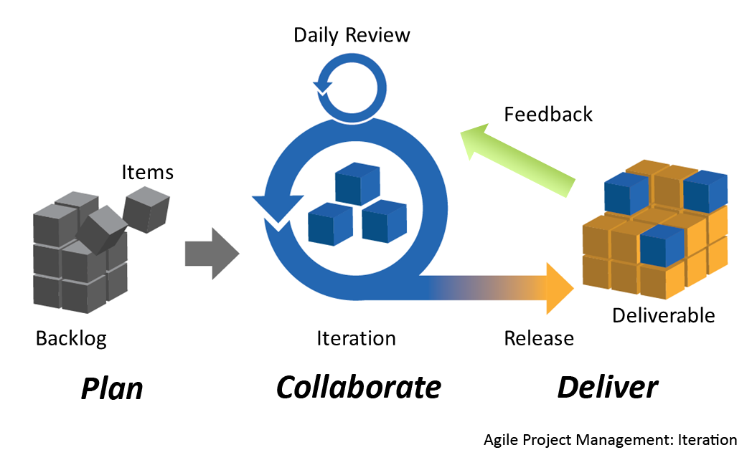
Agile Methodologies

Slide 6
Agile Methodologies
Agile methodology emphasizes:
small design steps,
incremental development, and
frequent customer interactions.
The developers and customer together decide on the set of features and capabilities – to be incorporated in the next increment of the software.
Each iteration of development is of few weeks only.
The software is then released to the customers; who test and use the same and find bugs, and suggest fixes and updates.
Agile and OSSD models share many principles and values; however, there are also contrasting differences in the philosophy behind them.

Slide 7
Agile vs. OSSD Methodologies
As per Agile Manifesto [1],
“Our highest priority is to satisfy the customer through early and continuous delivery of valuable software.“
As per OSSD model,
The concept or analogy of customers does not exist in Open Source Software. There are contributors and users of the project / product.
The user community, indirectly, serves as the customers; frequent releases are made – in order to promote peer review, continuous and increased end-user involvement.
[1] : Principles behind the Agile Manifesto (http://agilemanifesto.org/principles.html)

Slide 8
Agile vs. OSSD Methodologies
As per Agile Manifesto [1],
“Welcome changing requirements, even late in development. Agile processes harness change for the customer's competitive advantage.“
As per OSSD model,
Open-source projects are not customer-driven; and hence often resist incorporation of major changes in the requirements.
However, there always exist the possibility of incorporating major changes by forking the project into a separate repository and making changes – done in case a larger set of community feels the need for the same.
[1] : Principles behind the Agile Manifesto (http://agilemanifesto.org/principles.html)

Slide 9
Agile vs. OSSD Methodologies
As per Agile Manifesto [1],
“Deliver working software frequently, from a couple of weeks to a couple of months, with a preference to the shorter time scale.“
As per OSSD model,
Delivering of code cycle in case of Open-source is much shorter – usually every night
Open-source follows the philosophy of : release early, release often.
[1] : Principles behind the Agile Manifesto (http://agilemanifesto.org/principles.html)

Slide 10
Agile vs. OSSD Methodologies
As per Agile Manifesto [1],
“Business people and developers must work together daily throughout the project.“
As per OSSD model,
There does not exist the concept of “business people” in case of Open-source projects;
However, end-users who participate in the project serve the same role.
[1] : Principles behind the Agile Manifesto (http://agilemanifesto.org/principles.html)

Slide 11
Agile vs. OSSD Methodologies
As per Agile Manifesto [1],
“Build projects around motivated individuals. Give them the environment and support they need, and trust them to get the job done.“
As per OSSD model,
Participation in open source projects is completely voluntary; self-motivated and self-driven people join open source community, out-of-interest and hence motivation is guaranteed.
Open-source projects use selected tools for project management, version control, bug and issue tracking, and discussion forums.
[1] : Principles behind the Agile Manifesto (http://agilemanifesto.org/principles.html)

Slide 12
Agile vs. OSSD Methodologies
As per Agile Manifesto [1],
“The most efficient and effective method of conveying information to and within a development team is face-to-face conversation.“
As per OSSD model,
This is a major point of difference between Agile methodologies and open source.
Open-source projects lay complete emphasis on written communication over face-to-face communication.
Additionally, open-source projects can be widely distributed, and don't require collocation
[1] : Principles behind the Agile Manifesto (http://agilemanifesto.org/principles.html)

Slide 13
Agile vs. OSSD Methodologies
As per Agile Manifesto [1],
“Working software is the primary measure of progress.“
As per OSSD model,
This principle perfectly holds true for the open source software development model as well.
[1] : Principles behind the Agile Manifesto (http://agilemanifesto.org/principles.html)

Slide 14
Agile vs. OSSD Methodologies
As per Agile Manifesto [1],
“Agile processes promote sustainable development. The sponsors, developers, and users should be able to maintain a constant pace indefinitely.”
As per OSSD model,
the spirit behind this principle is in some manner embraced by open source;
[1] : Principles behind the Agile Manifesto (http://agilemanifesto.org/principles.html)

Slide 15
Agile vs. OSSD Methodologies
As per Agile Manifesto [1],
“Continuous attention to technical excellence and good design enhances agility.”
As per OSSD model,
Open source model emphasizes heavily on good design, technical excellence and well-written documentation.
[1] : Principles behind the Agile Manifesto (http://agilemanifesto.org/principles.html)

Slide 16
Agile vs. OSSD Methodologies
As per Agile Manifesto [1],
“Simplicity--the art of maximizing the amount of work done--is essential.”
As per OSSD model,
Since open source projects mostly rely on voluntary commitments, and not contractual commitments, hence the amount of work done is never a point of major concern.
The amount of work to be done wholly depends on the beliefs of the individual developers.
[1] : Principles behind the Agile Manifesto (http://agilemanifesto.org/principles.html)

Slide 17
Agile vs. OSSD Methodologies
As per Agile Manifesto [1],
“The best architectures, requirements, and designs emerge from self-organizing teams.”
As per OSSD model,
Although, open-source projects might not state this explicitly, but the underlying philosophy behind the open source projects makes this being true for these projects
Self-organizing and self-motivated community does results in some of the best products, with best architecture and designs
[1] : Principles behind the Agile Manifesto (http://agilemanifesto.org/principles.html)

Slide 18
Agile vs. OSSD Methodologies
As per Agile Manifesto [1],
“At regular intervals, the team reflects on how to become more effective, and then tunes and adjusts its behavior accordingly”.
As per OSSD model,
Self-reflection is not a major activity carried out in most of the open source projects.
However, some of the mature open-source projects tend to evolve and implement some governance mechanisms.
[1] : Principles behind the Agile Manifesto (http://agilemanifesto.org/principles.html)

Slide 19
Conclusion
To summarize,
While both agile and open-source methodologies embrace a number of principles and values, some of which are parallel, but some are intersecting as well.
However, both of them
involve continuous interaction with the users during all phases of the development;
value good design and effective documentation;
engage self-organizing and self-motivated individuals; and
strive to develop software that is tailored especially for a class of users / customers.

Slide 20
Thank You!
In our next session:
Contributing to Open Source Software Projects

